Slide 1
Find Tool SQL Queries
Samantha Quell

Slide 2
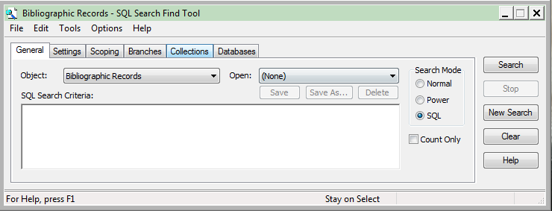
Agenda
Available Find Tools
SQL Find Tool Rules
SQL Find Tool Tips
Examples Find Tool Queries
Q&A

Slide 3
How Many Find Tools Does Polaris Have?
52

Slide 4
Available Find Tools – Acquisitions/Serials
Acquisitions:
Claims
Fiscal Years, Funds
Invoices, Invoice Line Items
Purchase Orders, Purchase Order Line Items, Purchase Order Templates
Selection Lists, Selection List Line Items
Suppliers
Serials:
Check-In Records
Claims
Issue Records
Part Records
Route Lists
Serial Holding Records
Subscription Records
Suppliers

Slide 5
Available Find Tools – Administrative
Administrative:
Branches
Collections
Libraries
Patron Records – Patron Registration View
Permission Groups
Resource Groups
Servers
Staff Members
System
Workstations

Slide 6
Available Find Tools – Cataloging/Patron Services
Cataloging (F12):
Authority Records, Authority Templates
Bibliographic Records, Bibliographic Templates
Campaigns, Community Records, Promotions
Course Reserve Records, Course Reserve Templates
Item Records, Item Record Templates
Record Sets
Reserve Item Records, Reserve Item Templates
Patron Services (F7):
Course Reserve Records, Course Reserve Templates
Patron Records – Patron Registration View
Record Sets
Circulation (F6):
Bibliographic Records – opens the Holds Queue WF
Hold Requests – opens the Holds Request WF
ILL Requests – opens the ILL Request WF
Item Records – opens the Holds Queue WF
Patron Records – Patron Status View

Slide 7
SQL Find Tool Rules
You can only select ONE column and it must be the ID field.
Bibliographic Records – BibliographicRecordID
Patron Records – PatronID
Item Records – ItemRecordID
Hold Requests – SysHoldRequestID
ILL Requests – ILLRequestID
Funds – FundID
Purchase Orders – PurchaseOrderID
You cannot use an ORDER BY.
All sorting must be done in the find tool after the results are loaded.
You cannot include comments in your query.
If you include a comment (-- comment), the find tool will ignore criteria following the comment.

Slide 8
SQL Find Tool Tips
Use the database help to find the right SQL tables and column names.
Write your query in SQL Sever Management Studio first
SSMS has IntelliSense, which helps prevent typos in table/column names
Nest your SQL queries
Useful when you need different WHERE criteria from the same field, such as bibliographic tag data or item status.
Use a HAVING to find results based on a COUNT
While you cannot select a COUNT value in the find tool, you can use counts in a HAVING clause to help restrict your result set.

Slide 9
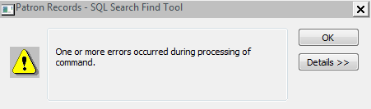
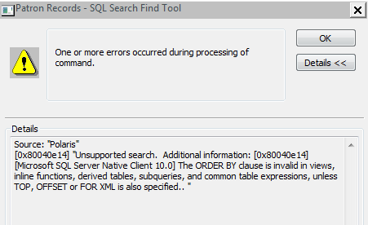
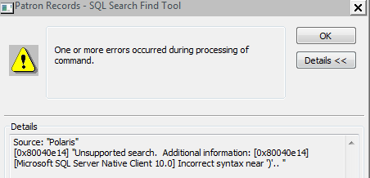
SQL Find Tool Tips
If you get an error, check the “Details”

Slide 10
Example - Workstations
I’m planning to do some workstation cleanup. Is there an easy way to see which workstations have not been used in a while?
Table:
Workstations
Query:

Slide 11
Example - Workstations
I’m planning to do some workstation cleanup. Is there an easy way to see which workstations have not been used in a while?
Table:
Workstations
Query:
SELECT WorkstationID
FROM Workstations (nolock)
WHERE Enabled = 1
AND StatusDate < '2014-01-01'

Slide 12
Example - Patrons
How can I find patrons with “None” as their notification option?
Table:
PatronRegistration
Query:

Slide 13
Example - Patrons
How can I find patrons with “None” as their notification option?
Table:
PatronRegistration
Query:
SELECT PatronID
FROM PatronRegistration (nolock)
WHERE DeliveryOptionID is null

Slide 14
Example - Patrons
I need to generate a list of all patrons who have 15 or more fiction items out.
Tables:
ItemCheckouts, CircItemRecords
Query:

Slide 15
Example - Patrons
I need to generate a list of all patrons who have 15 or more fiction items out.
Tables:
ItemCheckouts, CircItemRecords
Query:
SELECT PatronID
FROM ItemCheckouts ico (nolock)
INNER JOIN CircItemRecords cir (nolock)
ON cir.ItemRecordID = ico.ItemRecordID
WHERE cir.AssignedCollectionID in (1,335,4,337,338,339,342,354,369,370,414)
GROUP BY PatronID
HAVING COUNT(ico.ItemRecordID) >= 15

Slide 16
Example – Bibliographic Records
Is there a way to easily locate all of our Overdrive bibliographic records?
Tables:
Bibliographic Tags, Bibliographic Subfields
Query:

Slide 17
Example – Bibliographic Records
Is there a way to easily locate all of our Overdrive bibliographic records?
Tables:
Bibliographic Tags, Bibliographic Subfields
Query:
SELECT BibliographicRecordID
FROM BibliographicTags bt (nolock)
INNER JOIN BibliographicSubfields BS (nolock)
ON (bt.BibliographicTagID = bs.BibliographicTagID)
WHERE TagNumber = 856
AND bs.Subfield LIKE 'u'
AND bs.Data LIKE '%overdrive%'

Slide 18
Example – Bibliographic Records
Now that we have all the Overdrive records, is there a way to view just a subset of records? Specifically those with a 300 $b?
Tables:
Bibliographic Tags, Bibliographic Subfields
Query:

Slide 19
Example – Bibliographic Records
Now that we have all the Overdrive records, is there a way to view just a subset of records? Specifically those with a 300 $b?
Tables:
Bibliographic Tags, Bibliographic Subfields
Query:
SELECT BibliographicRecordID
FROM BibliographicTags bt (nolock)
INNER JOIN BibliographicSubfields BS (nolock)
ON (bt.BibliographicTagID = bs.BibliographicTagID)
WHERE TagNumber = 300 AND bs.Subfield LIKE ('b')
AND BibliographicRecordID in
(SELECT BibliographicRecordID
FROM BibliographicTags bt (nolock)
INNER JOIN BibliographicSubfields BS (nolock)
ON (bt.BibliographicTagID = bs.BibliographicTagID)
WHERE TagNumber = 856
AND bs.Subfield LIKE 'u'
AND bs.Data LIKE '%overdrive%')

Slide 20
Example – Bibliographic Records
I need a way to monitor all of the items appearing in the catalog with a 0 of 0 availability. Sometimes there are materials that go lost that I am not aware of, but I want to know about them so that I can choose to reorder before a hold is placed.
Tables:
BibliographicRecords, CircItemRecords
Query:

Slide 21
Example – Bibliographic Records
I need a way to monitor all of the items appearing in the catalog with a 0 of 0 availability. Sometimes there are materials that go lost that I am not aware of, but I want to know about them so that I can choose to reorder before a hold is placed.
Tables:
BibliographicRecords, CircItemRecords
Query:
SELECT br.bibliographicrecordid
FROM BibliographicRecords br (nolock)
LEFT JOIN CircItemRecords cir (nolock)
ON br.BibliographicRecordID = cir.AssociatedBibRecordID
WHERE br.BibliographicRecordID not in (
SELECT DISTINCT AssociatedBibRecordID
FROM CircItemRecords cir (nolock)
WHERE cir.ItemStatusID in (1,2,3,4,5,6,13,14,15,17,18,19,20))
AND br.RecordStatusID = 1
AND PrimaryMARCTOMID not in (6, 36, 41)
-- exclude eContent

Slide 22
Example - Items
I’m trying to locate all of our withdrawn fiction titles. Is there a way to do this by call number?
Tables:
CircItemRecords, ItemRecordDetails
Query:

Slide 23
Example - Items
I’m trying to locate all of our withdrawn fiction titles. Is there a way to do this by call number?
Tables:
CircItemRecords, ItemRecordDetails
Query:
SELECT i.ItemRecordID
FROM ItemRecordDetails i (nolock)
INNER JOIN CircItemRecords c (nolock)
ON i.ItemRecordID = c.ItemRecordID
WHERE i.CallNumber LIKE '%FIC%'
AND c.ItemStatusID = 11

Slide 24
Example - Items
I’m in High School and have a book report due on Friday. I need an available book with fewer than 100 pages!
Tables:
CircItemRecords, BibliographicTags, BibliographicSubfields
Query:

Slide 25
Example - Items
I’m in High School and have a book report due on Friday. I need an available book with fewer than 100 pages!
Tables:
CircItemRecords, BibliographicTags, BibliographicSubfields
Query:
SELECT cir.ItemRecordID
FROM CircItemRecords cir (nolock)
INNER JOIN BibliographicTags bt (nolock)
ON cir.AssociatedBibRecordID = bt.BibliographicRecordID
INNER JOIN BibliographicSubfields bs (nolock)
ON bs.BibliographicTagID = bt.BibliographicTagID
WHERE ItemStatusID = 1
AND bt.TagNumber = 300
AND bs.Subfield = 'a'
AND bs.Data LIKE '[0-9][0-9] p%'

Slide 26
Example – Holds Queue
I need a list of all the highly requested adult fiction so I can put them in a record set and order more copies.
Tables:
CircItemRecords, SysHoldRequests
Query:

Slide 27
Example – Holds Queue
I need a list of all the highly requested adult fiction so I can put them in a record set and order more copies.
Tables:
CircItemRecords, SysHoldRequests
Query:
SELECT DISTINCT BibliographicRecordID
FROM CircItemRecords cir (nolock)
INNER JOIN SysHoldRequests shr (nolock)
ON shr.BibliographicRecordID = cir.AssociatedBibRecordID
WHERE cir.AssignedCollectionID = 1
GROUP BY Shr.BibliographicRecordID
HAVING COUNT(SysHoldRequestID) > 5

Slide 28
Example – Hold Requests
Is there a way to identify every the bibliographic records with holds that do not have any "actually existing" items attached? By "actually existing" I mean that every attached item is lost, missing, withdrawn, or otherwise physically gone from the library.
Tables:
CircItemRecords, SysHoldRequests
Query:

Slide 29
Example – Hold Requests
Is there a way to identify every the bibliographic records with holds that do not have any "actually existing" items attached? By "actually existing" I mean that every attached item is lost, missing, withdrawn, or otherwise physically gone from the library.
Tables:
SysHoldRequests, CircItemRecords
Query:
SELECT shr.bibliographicrecordid
FROM sysholdrequests shr (nolock)
WHERE shr.BibliographicRecordID not in (
SELECT DISTINCT AssociatedBibRecordID
FROM CircItemRecords cir (nolock)
WHERE cir.ItemStatusID in (1,2,3,4,5,6,13,15,17,18,19,20))

Slide 30
Example – Transactions
How many distinct patrons have checked-out materials at my branch in the last month?
Tables:
TransactionHeaders, TransactionDetails
Query:

Slide 31
Example – Transactions
How many distinct patrons have checked-out materials at my branch in the last month?
Tables:
TransactionHeaders, TransactionDetails
Query:
SELECT DISTINCT td.numvalue
FROM PolarisTransactions..TransactionHeaders th (nolock)
INNER JOIN PolarisTransactions..TransactionDetails td (nolock)
ON th.TransactionID = td.TransactionID
WHERE TransactionTypeID = 6001
AND TransactionSubTypeID = 6
AND th.OrganizationID = 3
AND TranClientDate > GETDATE()-30

Slide 32

Q&A

